Slide 1
Capstone Project — A Study on small business in Buffalo
06/24/2020

Slide 2
Outline
Background
Data Preparation
Methodology
Results & Discussion
Conclusion

Slide 3
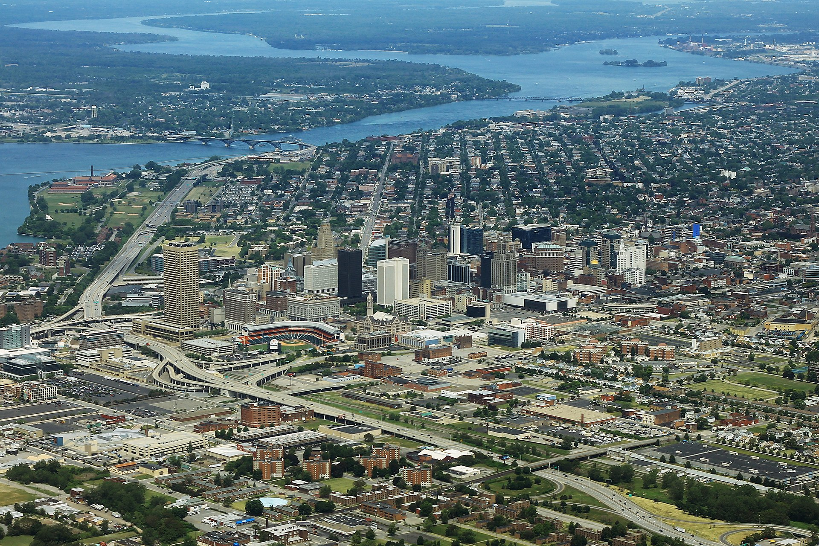
Background
Buffalo is the second largest city in the U.S. state of New York and the largest city in Western New York.
Business problem: you live in Buffalo and plan to do some investment or start your own business.
Target audience: entrepreneurs or business owners who want to start a new business or invest in the existing businesses in Buffalo
Objective:
which district is likely to have more potential customers
how many different types of venues there are in this district
what the most popular venues in this area are
https://en.wikipedia.org/wiki/Buffalo,_New_York

Slide 4
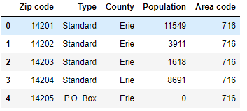
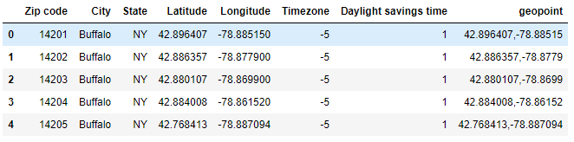
Data Preparation
The population data in each district of Buffalo:
https://www.zip-codes.com/city/ny-buffalo.asp
The zip code latitude and longitude data of Buffalo: https://public.opendatasoft.com/explore/dataset/us-zip-code-latitude-and-longitude/table/?q=buffalo
The information on venues in Buffalo:
obtained by utilizing Foursquare API

Slide 5
Methodology
Select the districts suitable for small businesses in Buffalo
Explore the venues in selected districts (Foursquare API)
What venues are popular in each district (one hot encoding)
K-Means Clustering

Slide 6
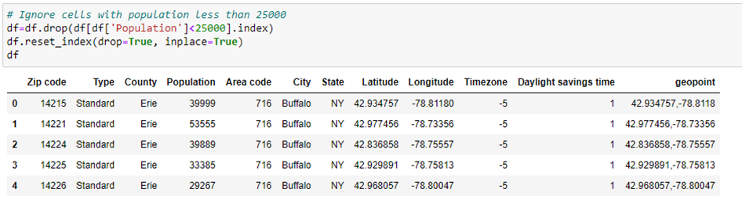
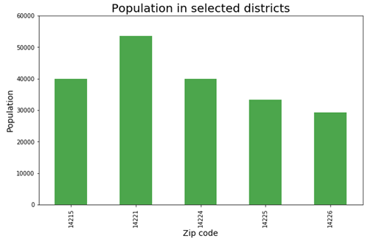
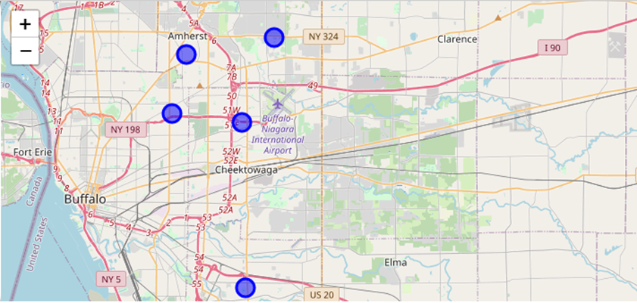
Results & Discussion
Select the districts suitable for small businesses in Buffalo
Merged the population data and geopoint data to get the population data in each district of Buffalo
Find a place where there are more potential customers--The larger population, the better
population larger than 25,000

Slide 7
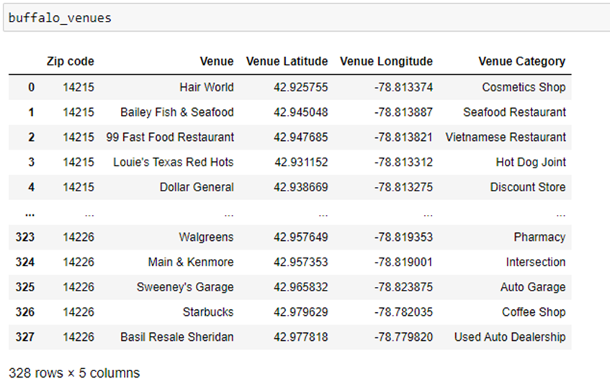
Results & Discussion
Explore the venues in selected districts
By utilizing the Foursquare API, a function to look up the venues was defined
The venues in each district were obtained (includes the venue name, latitude, longitude and category data)
Total number of unique categories in these selected areas is 130.

Slide 8
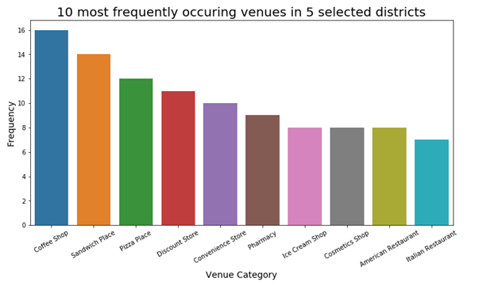
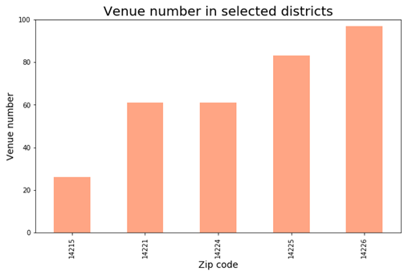
Results & Discussion
Explore the venues in selected districts
The number of each unique category was counted and assorted (5 districts were treated as a whole)
The top three venue categories:
coffee shops
sandwich places
pizza places
Although 14225 and 14226 districts were ranked as the fourth and fifth in population, the venue number in these two districts were higher than the other three districts

Slide 9
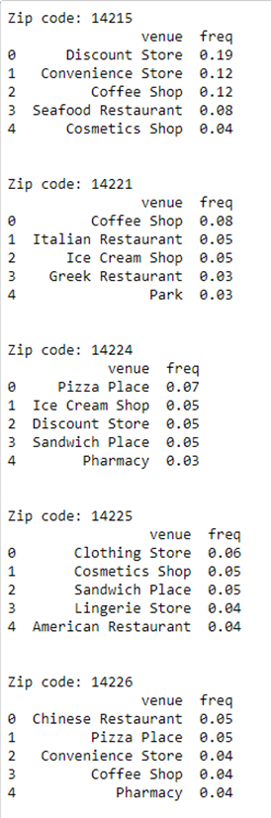
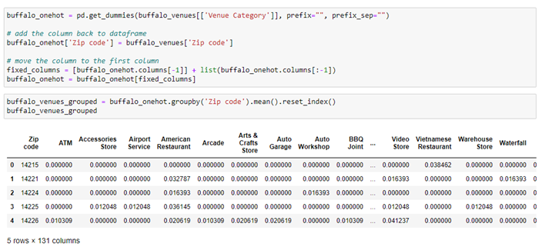
Results & Discussion
One hot coding
Transform categorical data into numerical data
District 14221: coffee shops, Italian restaurants and ice cream shops are more popular
District 14225: clothing stores, sandwich places and cosmetics shops are more popular
District 14226: Chinese restaurants and pizza places are more popular

Slide 10
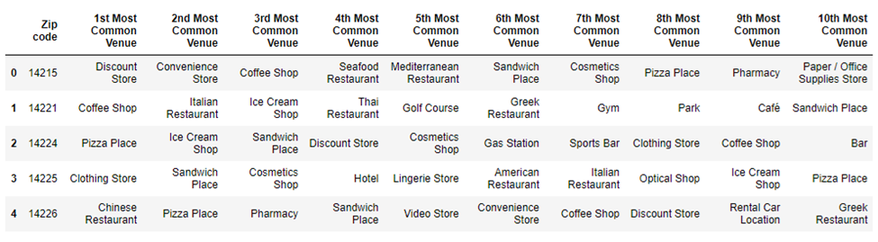
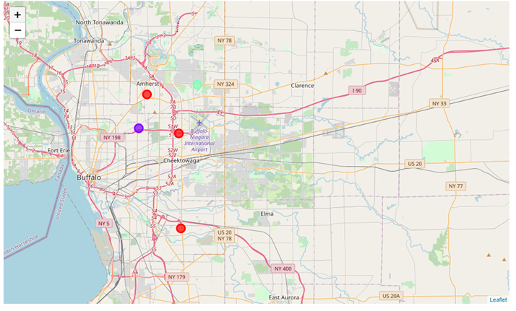
Results & Discussion
K Means Clustering
Three clusters
Cluster 0: 14224, 14225 and 14226
Cluster 1: 14215
Cluster 2: 14221

Slide 11
Conclusion
Overall, coffee shops, sandwich places and pizza places are the three most popular venues in five major districts (14215, 14221, 14224, 14225 and 14226) in Buffalo
District 14221 is more likely to have more potential customers, and coffee shops, Italian restaurants and ice cream shops are most popular in this area
District 14225 and 14226 has more venues survived. In district 14225, clothing stores, sandwich places and cosmetics shops are more popular; in district 14226, Chinese restaurants and pizza places are more popular

